Slide 1

ITA0329-MOBILE COMPUTING
APPLIANCES PROJECT TITLE
Peer-to-Peer File Sharing & Chat Application for Mobile
PRESENTED BY
K.BALAJI(192324180)
GUIDED BY
Dr.Saravanan.M.S

Slide 2


INDEX
ABSTRACT
INTRODUCTION
PROBLEM STATEMENT AND OBJECTIVES
EXISTING SYSTEM AND PROPOSED SYSTEM
METHODOLOGY
MODULES
RESULTS
IEEE STANDARDS
SDG CONTRIBUTION
CONCLUSION
REFERENCES

Slide 3
ABSTRACT
Peer-to-Peer File Sharing & Chat Application for Mobile
A Peer-to-Peer (P2P) File Sharing and Chat Application for Mobile enables users to share files and exchange messages directly between mobile devices without a centralized server. It uses NSD, Wi-Fi Direct, and socket programming to discover nearby devices and establish connections. AES encryption secures data, while chunked file transfer supports large files.
Purpose of the Project
The system aims to provide secure, fast, and reliable file sharing with real-time transfer progress. It reduces dependence on internet-based services and evaluates performance using transfer speed, success rate, and connection setup time.

Slide 4
INTRODUCTION
□ The Peer-to-Peer File Sharing & Chat Application for Mobile enables users to share files and exchange messages directly between mobile devices without a central server.
□ It uses wireless connectivity, peer discovery, and AES encryption to provide secure and efficient communication.
Importance:
□ This system:
Enables direct file sharing and chatting.
Protects data using encryption.
Supports large file transfers with progress tracking.
Reduces dependence on centralized services.
□ It provides a secure and convenient solution for mobile communication and data sharing.

Slide 5
PROBLEM STATEMENTS AND OBJECTIVES
Problem Statement:
□ Traditional file-sharing applications often depend on the internet or centralized servers. Sharing large files between mobile devices can be inconvenient, and unsecured transfers may expose sensitive data. A secure, direct, and efficient mobile file-sharing and chat system is needed.
Objectives:
For Peer Discovery & Connection Module:
□ To discover nearby mobile devices and establish peer-to-peer connections.
□ To maintain a decentralized peer list for communication and file sharing.
For Secure File Sharing & Chat Module:
□ To transfer files and messages securely using AES encryption.
□ To support large file transfers with progress tracking and evaluate transfer speed, success rate, and connection setup time.

Slide 6
EXISTING SYSTEM AND PROPOSED SYSTEMS
Existing System:
File sharing depends on internet services or centralized servers.
Limited direct communication between nearby mobile devices.
Large file transfers may be slow or difficult to manage.
Data security may be insufficient in some applications.
Limited visibility into file transfer progress.
Proposed System:
Enables direct peer-to-peer file sharing and chatting.
Discovers nearby devices using NSD or Wi-Fi Direct.
Uses AES encryption to protect files and messages.
Supports large files through chunked transfer.
Displays transfer progress and measures speed and success rate.

Slide 7
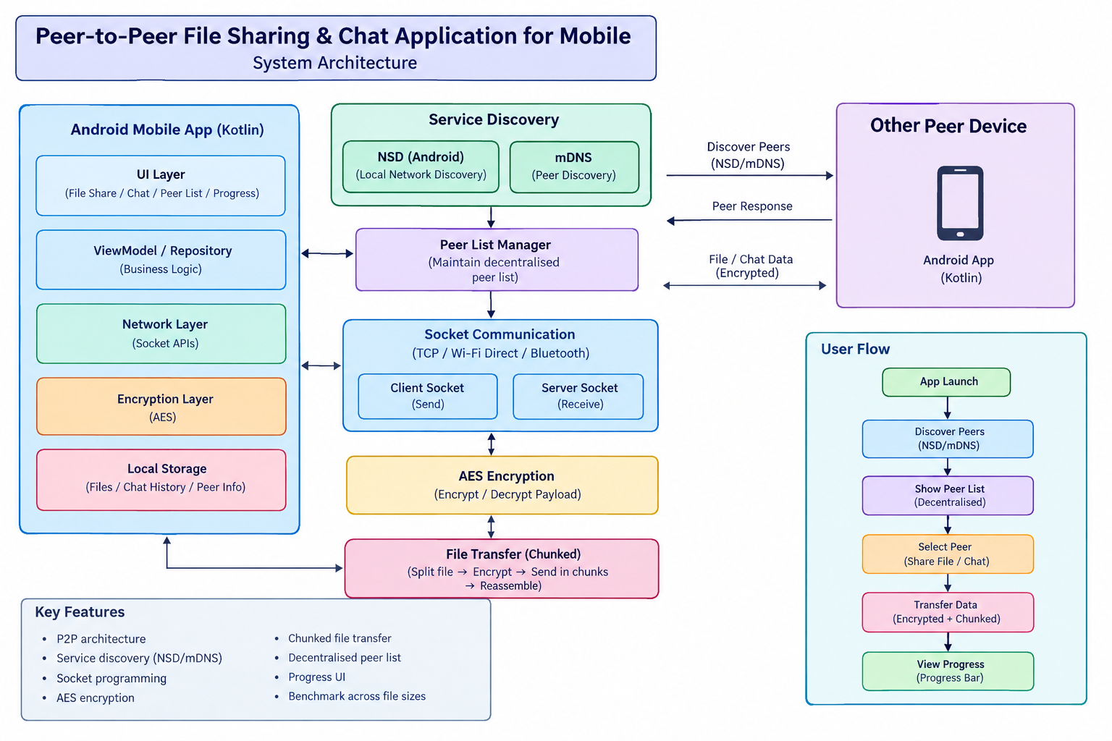
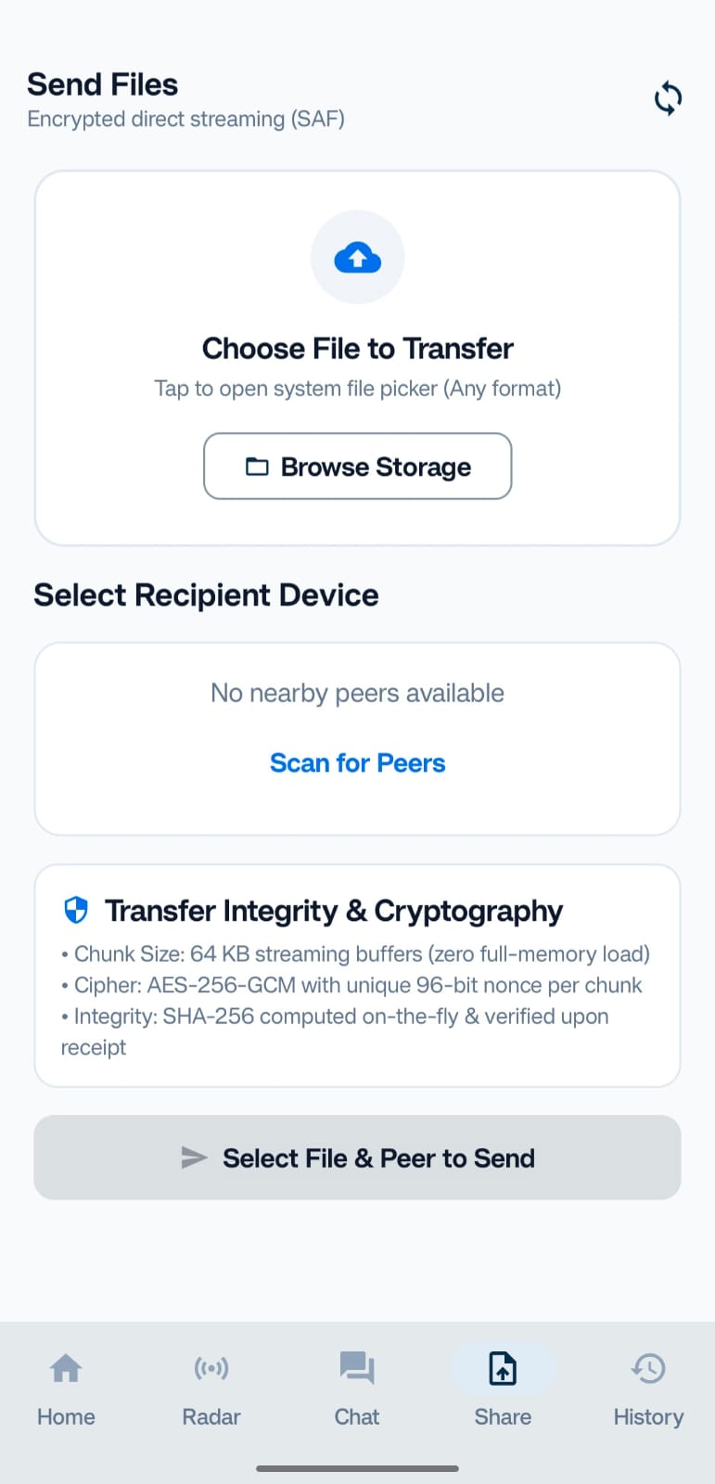
METHODOLOGY
ARCHITECTURE DIAGRAM IMPLEMENTATION IMAGE

Slide 8
Software Requirements
S. No. | Software / Technology | Purpose
1 | Android Studio | Develop and run the Android application
2 | Kotlin | Android application programming
3 | Jetpack Compose | Design the user interface
4 | Android SDK | Build and test the application
5 | Antigravity | AI-assisted coding and implementation
6 | TCP Socket API | Transfer files and messages between devices
7 | Android NSD / mDNS | Discover nearby devices on a local network
8 | Wi-Fi Direct API | Enable direct wireless connections between supported devices
9 | Java Cryptography Architecture (JCA) | Implement AES-GCM encryption and SHA-256 integrity checking
10 | Git and GitHub (optional) | Version control and project backup

Slide 9
Module 1: Peer Discovery and Connection
Discover nearby mobile devices using NSD/mDNS.
Display available devices in a peer list.
Establish direct connections between devices using TCP sockets.
Show connection status (connected/disconnected).
Allow users to select a device for communication.
Maintain a list of active peers.
Enable communication without a centralized server.
Provide the connection foundation for chat and file sharing.
Software Used: Android Studio, Kotlin, Android SDK, NSD/mDNS API, and TCP Socket API.
Expected Output: Nearby devices are displayed, and users can connect to a selected device for peer-to-peer communication.

Slide 10
Module 2: Secure File Sharing and Chat
Enable real-time text messaging between connected mobile devices.
Allow users to select and share files from their mobile storage.
Use AES encryption to protect messages and files during transfer.
Support large file transfers using chunk-based transmission.
Display file transfer progress, speed, and completion status.
Verify file integrity using SHA-256 hashing.
Handle transfer errors and connection interruptions.
Record transfer details for performance evaluation.
Software Used: Android Studio, Kotlin, TCP Socket API, Android File Picker, AES-GCM, and SHA-256.
Expected Output: Users can securely exchange messages and files between connected mobile devices while monitoring transfer progress.

Slide 11
RESULTS
Successfully designed the Peer-to-Peer (P2P) File Sharing and Chat Application for mobile devices.
Enabled nearby device discovery using NSD/mDNS.
Established direct connections between mobile devices using TCP sockets.
Implemented text messaging between connected peers.
Enabled file sharing with transfer progress monitoring.
Applied AES encryption to protect messages and files during transfer.
Used SHA-256 hashing to verify file integrity.
Evaluated transfer speed, connection setup time, and transfer success rate.
Expected Result: The application provides secure, reliable, and convenient file sharing and chat between mobile devices without depending on a centralized server.

Slide 12
IEEE STANDARDS
IEEE 802.11: Supports wireless communication over Wi-Fi networks between mobile devices.
IEEE 802.11 Direct (Wi-Fi Direct): Supports direct wireless connections between compatible devices without requiring a traditional Wi-Fi access point.
IEEE 802.15.1: Related to Bluetooth wireless communication; relevant if Bluetooth file transfer is included.
IEEE 802.11i: Provides a foundation for Wi-Fi security mechanisms.

Slide 13
SDG CONTRIBUTION
SDG 9 – Industry, Innovation and Infrastructure: Promotes innovative mobile technology through peer-to-peer communication and direct file sharing.
SDG 12 – Responsible Consumption and Production: Encourages efficient digital file sharing and reduces unnecessary dependence on physical storage devices.
SDG 16 – Peace, Justice and Strong Institutions: Supports data privacy through encrypted communication and secure file transfer.
SDG 4 – Quality Education: Helps students and educators exchange academic files and learning materials conveniently.

Slide 14
CONCLUSION
The Peer-to-Peer File Sharing and Chat Application enables direct communication between mobile devices without a centralized server.
It uses NSD/mDNS for device discovery and TCP sockets for reliable communication.
The application supports text messaging and file sharing between connected devices.
AES encryption helps protect data, while SHA-256 hashing helps verify file integrity.
Transfer progress monitoring improves usability and helps users track file-sharing activities.
The system can be evaluated based on transfer speed, connection setup time, and transfer success rate.

Slide 15
REFERENCES
I Kelényi, G Csúcs, B Forstner, H Charaf,Mobile Phone Programming: Application to Wireless Networking, 2007•Springer
Jabbar, W.A., Ismail, M. and Nordin, R., 2013, April. Peer-to-peer communication on android-based mobile devices: Middleware and protocols. In 2013 5th International Conference on Modeling, Simulation and Applied Optimization (ICMSAO) (pp. 1-6). IEEE.
Shakor, M.Y., Khaleel, M.I., Safran, M., Alfarhood, S. and Zhu, M., 2024. Dynamic AES encryption and blockchain key management: a novel solution for cloud data security. IEEE Access, 12, pp.26334-26343.
Shoumy, N.J., Rahaman, D.M., Khatun, S., Azhani, W.N., Ariff, M.H., Morshed, M.N., Islam, M., Manap, S.N.A. and Jusof, M.F.M., 2020, March. Multi-hop File Transfer in WiFi Direct Based Cognitive Radio Network for Cloud Back-Up. In InECCE2019: Malaysia, 29th July 2019 (pp. 389-400). Singapore: Springer Singapore.

Slide 16


